Slide 1
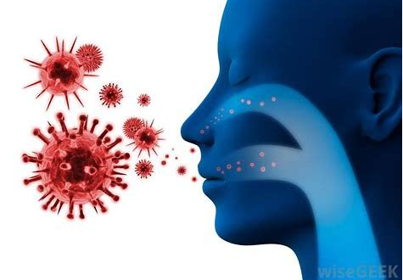
Daily Review
A disease is anything that causes the body to stop working properly. Pathogens are microorganisms which cause disease.
What are four different types of pathogen?

Slide 2
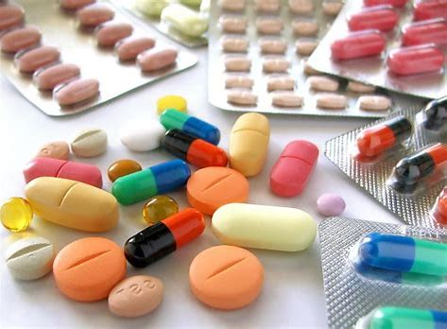
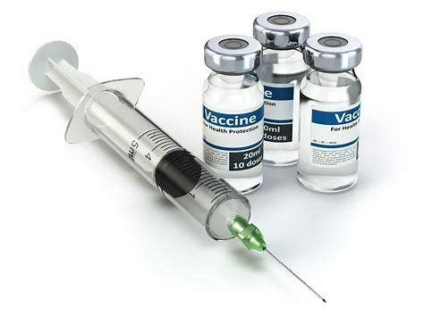
Daily Review
Antibiotics release chemicals that destroy bacteria by breaking down their cell walls.
Why do antibiotics not destroy viruses?
Why do antibiotics not harm human cells?
A vaccine is created by taking a small amount of the inactive virus or poison produced by the bacterium.
Our immune system responds by making antibodies and we become immune to the pathogen. Our bodies can respond much quicker and prevent the disease if it enters in the future.
How are vaccines different to antibiotics?

Slide 3
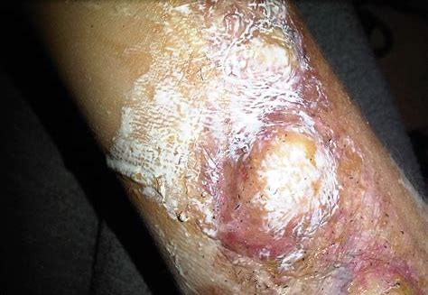
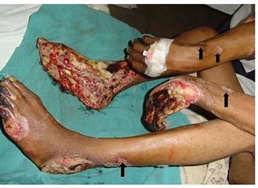
Daily Review
Reminder
Can this disease be treated with antibiotics? Why/why not?
CFU 2
Can this disease be prevented with a vaccine?
Bubonic plague is severe infectious disease caused by the bacterium yersinia pestis. Its symptoms include infected, enlarged, and painful lymph nodes, known as buboes, and gangrene.
How could this disease be treated?

Slide 4
The Immune System
Year 9 Biology

Slide 5
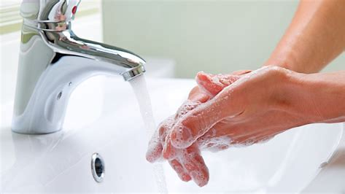
Learning Objectives
CFU
What are we going to learn?
Describe first two ways the immune system responds to pathogens in the body.
Activate Prior Knowledge
Humans can change their behaviour to prevent contagious diseases from being contracted.
Think, Pair, Share:
What are some behaviours you carry out regularly to keep you free of pathogens?

Slide 6
Concept Development
CFU 1
What does the immune system do?
Immune System
The role of the immune system is to prevent pathogens from entering the body, and attacking them if they do enter.
The immune system has three lines of defence against pathogens:
1. Stop pathogens entering the body
2. Seek and destroy the pathogen if it enters the body
3. Develop immunity to a pathogen
CFU 2
Tell the person next to you: What are the body’s three immune defences?
CFU 3
Think, Pair, Share: Which defence would be active within the body most often? Why do you think this?

Slide 7
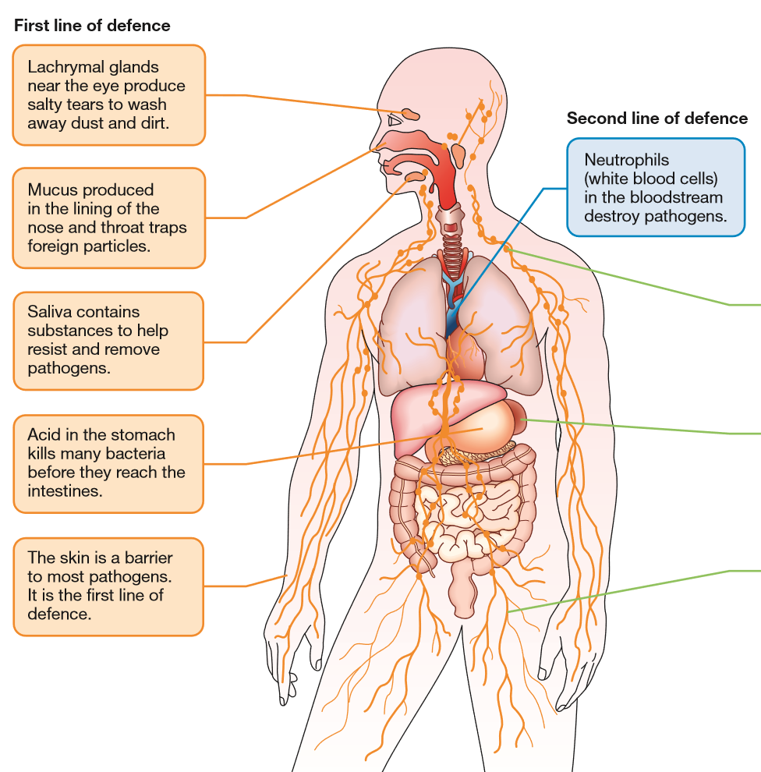
Concept Development
CFU 1
What is the body’s first defence against pathogens?
CFU 2
How does skin prevent pathogens entering the body?
First Defence
The body uses physical barriers and chemicals to prevent pathogens from entering the body.
It mainly consists of the skin and mucous membranes.
Skin is thick, waterproof, and difficult to damage.
It also has oil and sweat which help destroy bacteria.
Mucous membranes line the openings to the body (mouth, nose, ears, eyes, genitals, etc.).
The mucous in these areas can trap and kill pathogens.
CFU 3
Think, Pair, Share: What do the eyes and ears produce to help prevent pathogens entering the body?

Slide 8
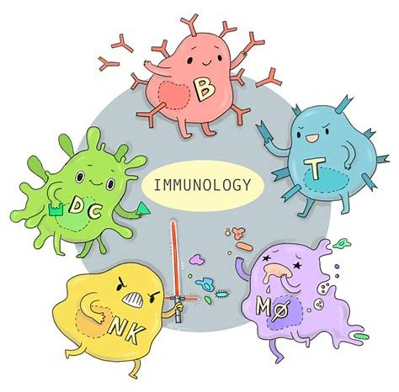
Concept Development
CFU 1
How does the immune system respond to pathogens?
Second Defence
When pathogens do enter the body, the immune system responds by attempting to destroy the pathogen.
This is a non-specific immune response as the body reacts the same way regardless of what type of pathogen is present.
First, the body ‘seeks and destroys’ the pathogen.
Second, white blood cells are released to help destroy the pathogen.
CFU 2
In your own words: What is a non-specific immune response?

Slide 9
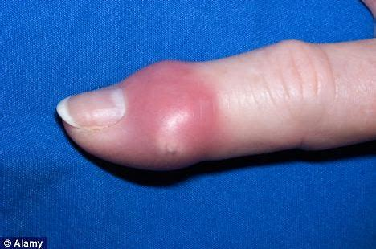
Concept Development
CFU 1
What three actions are involved in the body’s non-specific immune response?
Seek and Destroy
As part of the body’s second, non-specific immune response, the following actions occur:
Blood clotting to prevent additional infection through damage to the skin.
Inflammation to increase the blood cells reaching the affected area.
Fever to damage the pathogens that cannot function at high temperatures.
CFU 2
How does a fever help damage pathogens?

Slide 10
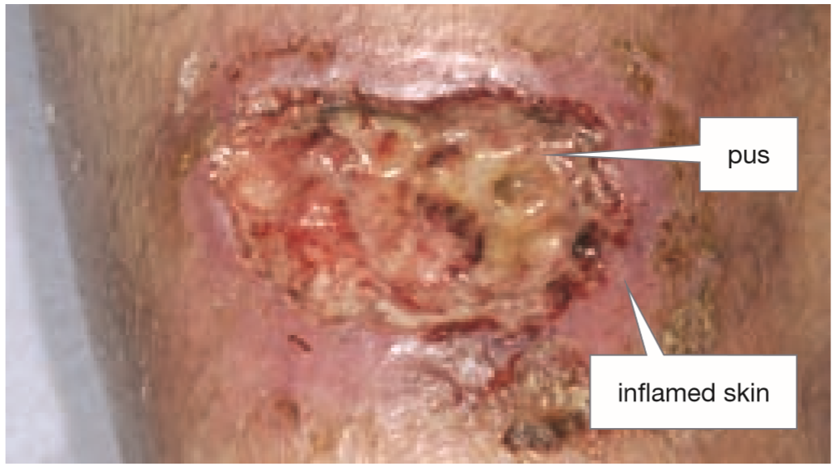
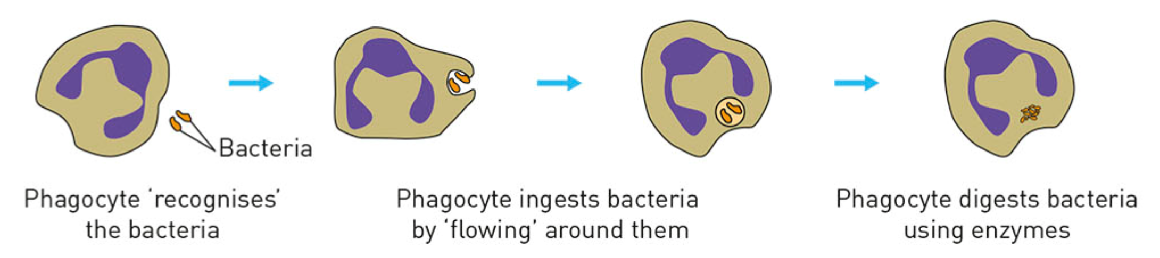
CFU 1
How does inflammation help the immune response?
Concept Development
CFU 2
What is the role of neutrophils?
White Blood Cells
As part of the body’s second, non-specific immune response, white blood cells are produced.
More white blood cells can reach the infected area due to increased blood flow through inflammation.
White blood cells also release chemical messengers to cause swelling in the area.
Neutrophils and phagocytes are specialised cells that engulf the pathogen, destroying them in a process called phagocytosis.
The neutrophils are destroyed in this process causing the yellow pus that collects in wounds.

Slide 11
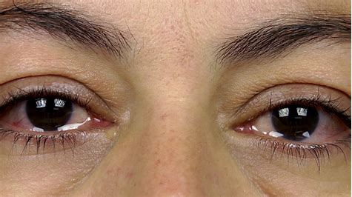
Skill Development/Guided Practice
CFU
Which line of defence is at work here?
Describe how the immune system functions to prevent pathogens entering the body through the eyes.
CFU
How does it prevent/destroy pathogens?
This is the body’s first line of defence. It prevents pathogens entering the body.
Tears from the eyes flush away pathogens.
Tears also contain chemicals that can destroy pathogens.

Slide 12
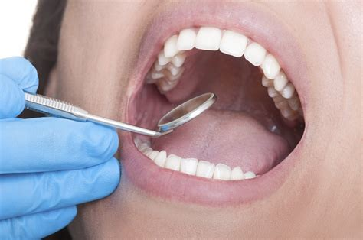
Skill Development/Guided Practice
CFU
Which line of defence is at work here?
Describe how the immune system functions to prevent pathogens entering the body through the mouth.
CFU
How does it prevent/destroy pathogens?
This is the body’s first line of defence. It prevents pathogens entering the body.
Mucous membranes trap pathogens.
Pathogens are swallowed and destroyed by stomach acid.

Slide 13
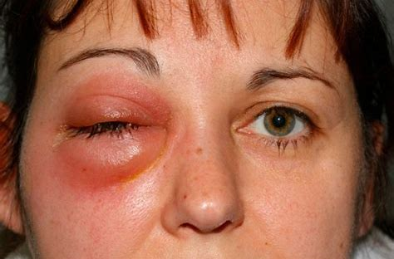
Skill Development/Guided Practice
CFU
Which line of defence is at work here?
Describe how the immune system functions to destroy pathogens through inflammation.
CFU
Are white blood cells involved?
This is the body’s second of defence. It destroys pathogens once they have entered the body.
Increased blood flow brings more white blood cells to the affected area.

Slide 14
Skill Development/Guided Practice
CFU
Which line of defence is at work here?
Describe how the immune system functions to destroy pathogens through neutrophils.
CFU
Are white blood cells involved?
This is the body’s second line of defence. It destroys pathogens once they have entered the body.
Neutrophils are white blood cells that engulf and destroy the pathogen.

Slide 15
Relevance
Our bodies are complex organisms that are constantly responding to changes in the external and internal environment.
Knowing about the immune system and defences of the body helps you understand how our body maintains its optimal internal environment and stops pathogens damaging our bodies.

Slide 16
Skill Closure
What is the role of the immune system?
Skill Closure
What is the body’s first major line of defence against pathogens?
Skill Closure
What are the three actions of the non-specific immune response?

Slide 17
Independent Practice
Use pages 62-63 of the textbook to answer the following questions:
What is the body’s first line of defence? Give two examples of how the body does this.
What is the body’s second line of defence? Give two examples of how the body does this.
What is a non-specific immune response?
What is the purpose of a white blood cell?
What is a phagocyte? Why is it sometimes compared to Pacman?
Marigold
Rafflesia
Trumpet Vine
Cactus
Jasmine
Bottlebrush

